Slide 1

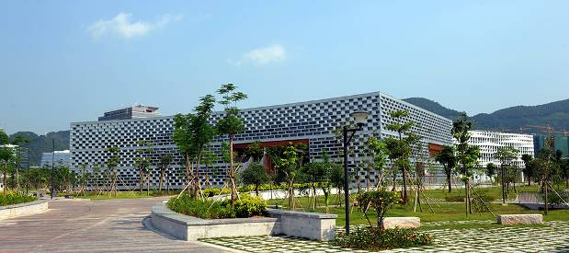
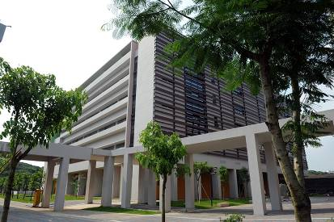
Engineering Electromagnetics 工程电磁场
Youwei Jia 嘉有为

Slide 2


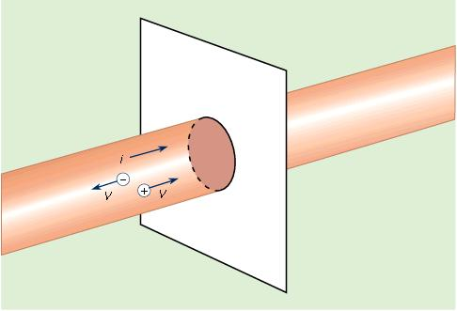
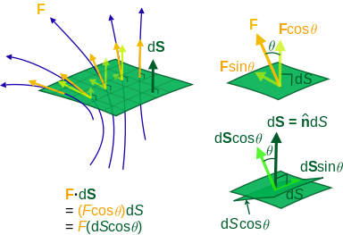
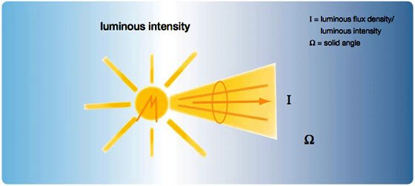
4: Concept of ‘Flux’ 通量
The word ‘ flux ’ comes from Latin: fluxus means “flow”, and fluere is “to flow” . 一个表征“流动”的量
Flux is defined as the rate of flow of a property through certain area. “通量”用来表示单位时间内流过特定面的某个量的多少
1

Slide 3
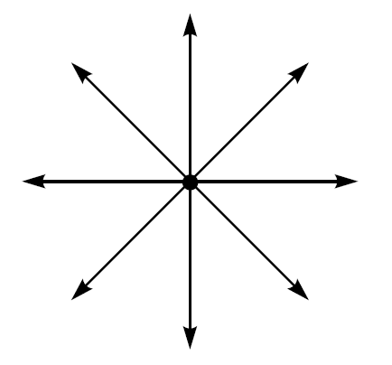
5: Electric Flux Density电通密度
Streamlines, Electric flux lines 电力线、电通量线
Let us be content to show only the direction of E by drawing continuous lines, which are everywhere tangent to E, from the charge.
These lines are usually called streamlines, although other terms such as flux lines通量线 and direction lines方向线 are also used.
Q6. Is it really that the magnitude of field can not be indicated with streamlines?
Q1. How can we define ‘flux’ when there is nothing projected outward from the point charge?
Note: There should be ‘something’ to indicate the ‘influence’ of this point charge on the space surrounding it. That is why we define ‘electric flux density’
2

Slide 4
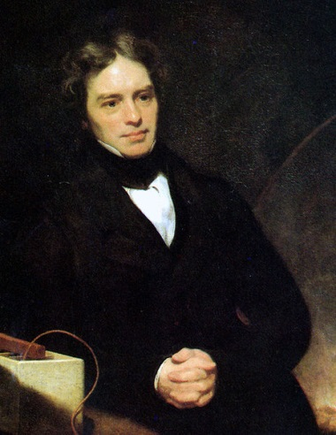
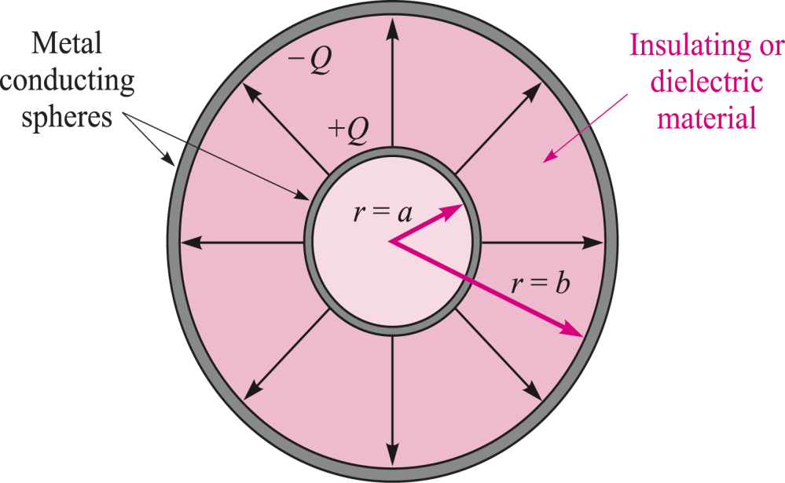
5: Electric Flux Density电通密度
Faraday Experiment
He started with a pair of metal spheres of different sizes; the larger one consisted of two hemispheres that could be assembled around the smaller sphere.
The inner charge, Q, induces an equal and opposite charge, -Q, on the inside surface of the outer sphere, by attracting free
electrons in the outer material toward
the positive charge.
Michael Faraday, (1791 – 1867 )
+Q
This means that before the outer sphere
is grounded, charge +Q resides on the
outside surface of the outer conductor.
Note: Herein, ‘induce’ is the ‘influence’ of this point charge on the outer metal sphere.
3

Slide 5

5: Electric Flux Density电通密度
Faraday Experiment
Attaching the ground connects the
outer surface to an unlimited supply
of free electrons, which then neutralize中和
the positive charge layer. The net charge
on the outer sphere is then the charge on
the inner layer, or -Q.
Michael Faraday, (1791 – 1867 )
Q = 0
Faraday found that the total charge on the outer sphere was equal in magnitude to the original charge placed on the inner sphere and that this was true regardless of the dielectric material separating the two spheres and the radius of the outer metal sphere.
Ground
attached
4

Slide 6
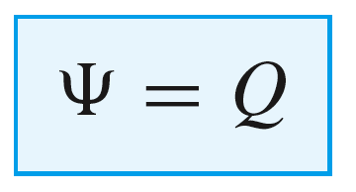
5: Electric Flux Density电通密度
Faraday Experiment- Electric Flux
Faraday concluded that there occurred
a charge “displacement” from the inner
sphere to the outer sphere.
Displacement involves a flow or flux, Ψ, existing
within the dielectric, and whose magnitude
is equivalent to the amount of “displaced” charge.
Michael Faraday, (1791 – 1867 )
Q = 0
Specifically:
Ground
attached
5

Slide 7
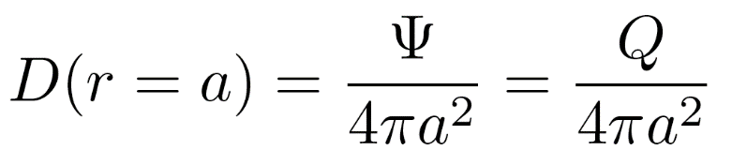
5: Electric Flux Density电通密度
Faraday Experiment-Electric Flux Density
Displacement involves a flow or flux, Ψ, existing
within the dielectric, and whose magnitude
is equivalent to the amount of “displaced” charge.
Specifically:
Michael Faraday, (1791 – 1867 )
Q = 0
The density of flux at the inner sphere surface is equivalent to the density of charge there (in Coul/m²)
Ground
attached
6

Slide 8
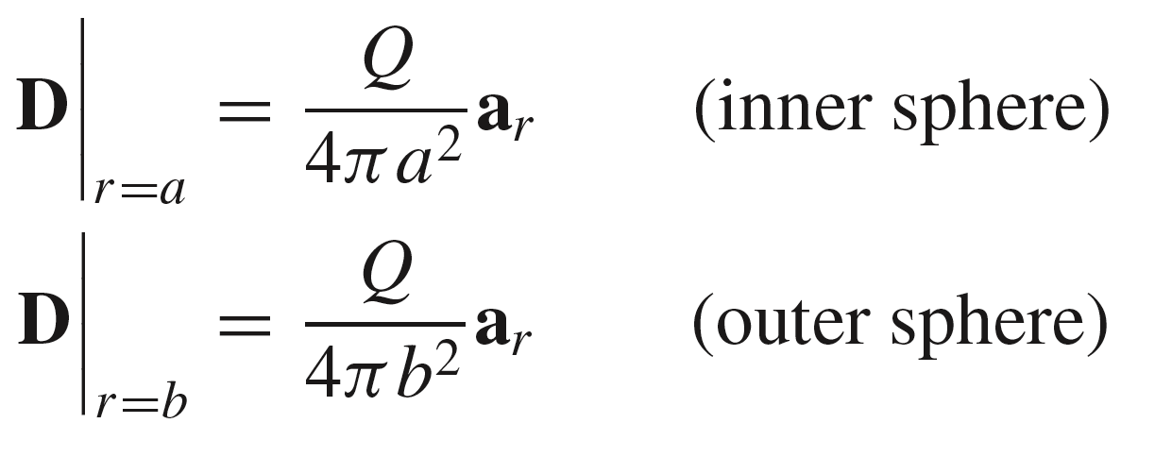
5: Electric Flux Density电通密度
Vector Field Description of Flux Density
A vector field is established which
points in the direction of the “flow”
or displacement. In this case, the
direction is the outward radial direction
in spherical coordinates. At each surface,
we would have:
Michael Faraday, (1791 – 1867 )
Q = 0
Ground
attached
7

Slide 9
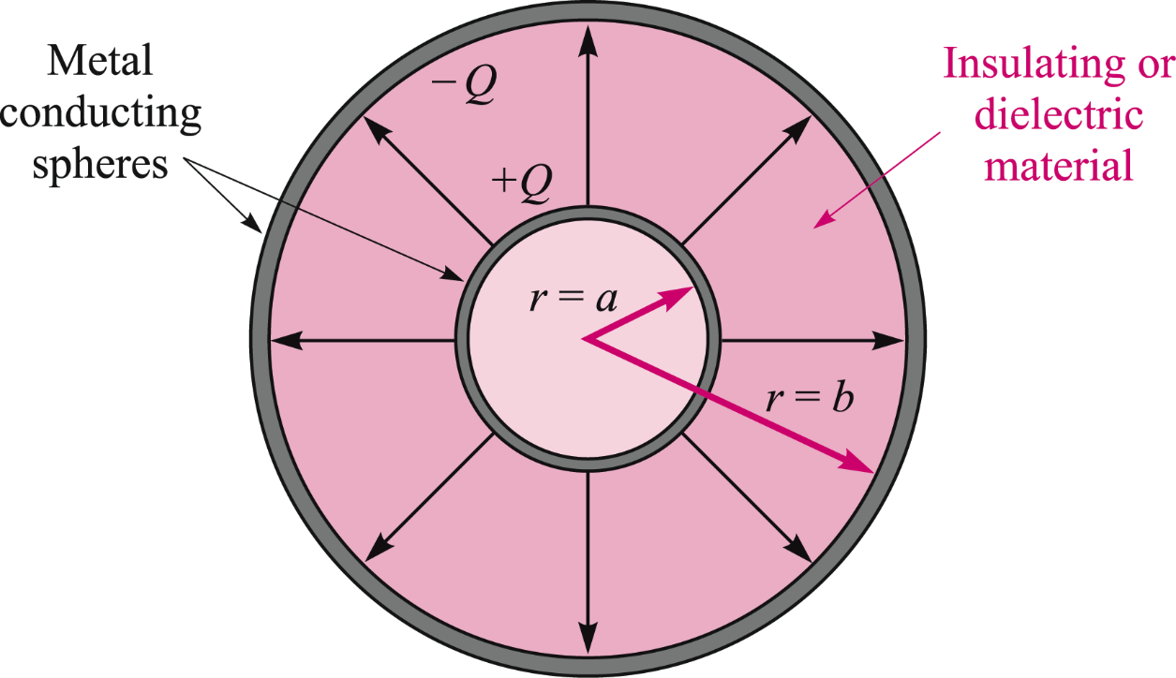
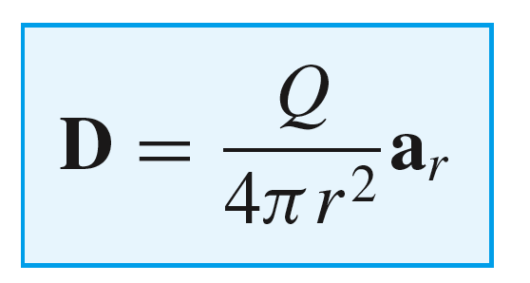
5: Electric Flux Density电通密度
Vector Field Description of Flux Density
At a general radius r between
spheres, we would have:
Q = 0
D(r)
r
Expressed in units of Coulombs/m², and
defined over the range (a ≤ r ≤ b)
8

Slide 10
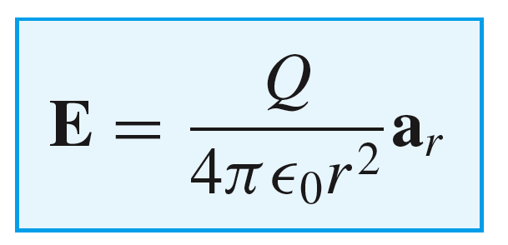
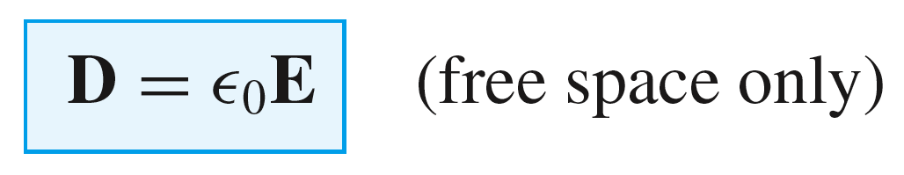
5: Electric Flux Density电通密度
Point Charge Fields – Relationship between E and D
If we now let the inner sphere radius reduce to a point, while maintaining the same charge, and let the outer sphere radius approach infinity, we have a point charge. The electric flux density is unchanged, but is defined over all space:
C/m² (0 < r <∞ )
We compare this to the electric field intensity in free space:
V/m (0 < r <∞ )
..and we see that:
9

Slide 11
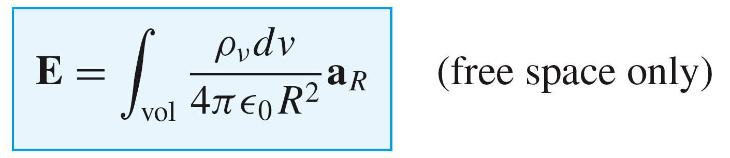
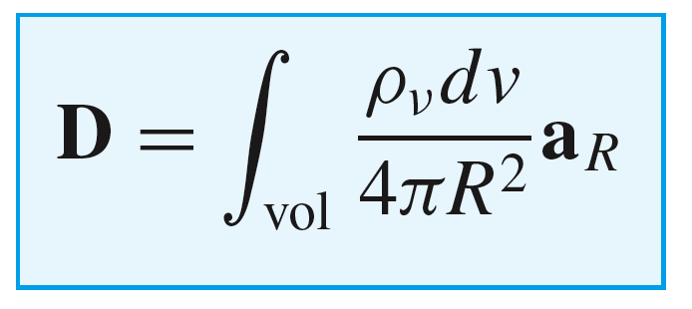
5: Electric Flux Density电通密度
Volume Charge Fields – Relationship between E and D
We learned in Chapter 2 that:
It now follows that:
..and we also see that:
10

Slide 12
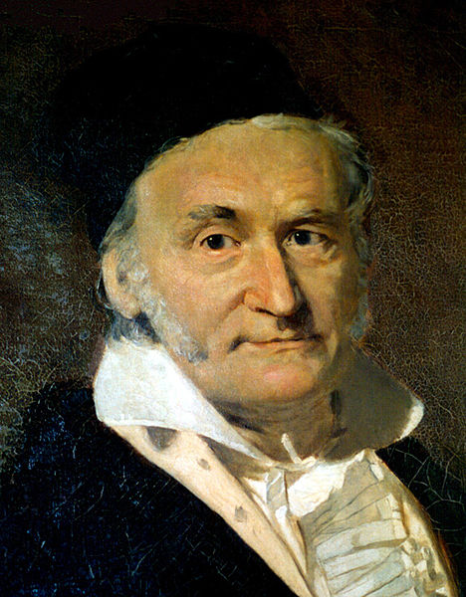
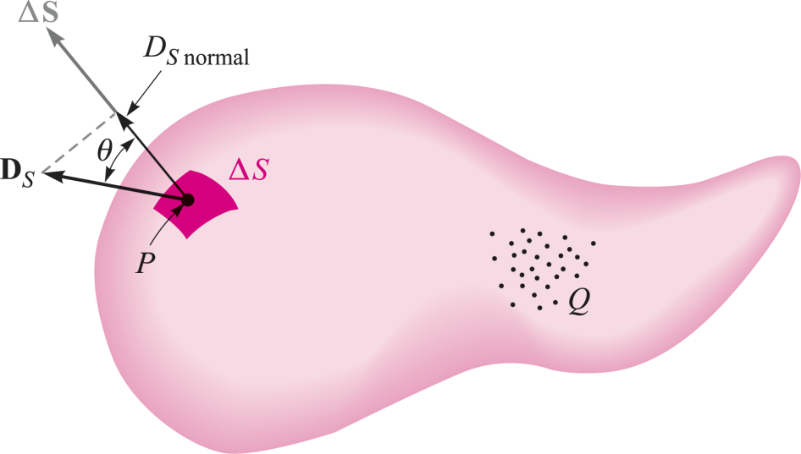
6: Gauss’ Law高斯定律
Gauss’ Law
The electric flux passing through any closed surface is equal
to the total charge enclosed by that surface
穿过任意闭合面的电通量等于该曲面所包含的总电荷
Carl Friedrich Gauss (1777 -1855)
11

Slide 13
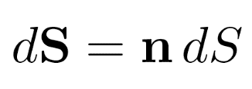
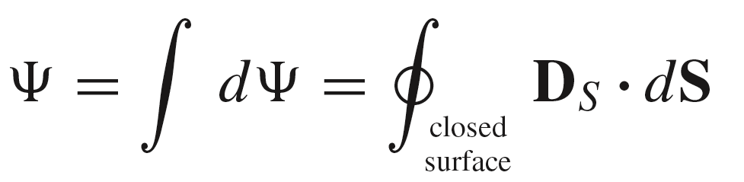
6: Gauss’ Law高斯定律
Gauss’ Law- Its mathematical statement
The electric flux passing through any closed surface is equal
to the total charge enclosed by that surface
穿过任意闭合面的电通量等于该曲面所包含的总电荷
We define the differential
surface area (a vector) as
where n is the unit outward
normal vector to the surface,
and where dS is the area of the
differential spot on the surface
12

Slide 14
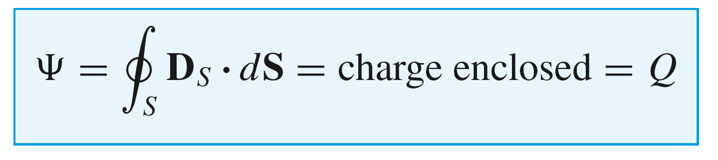
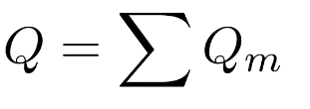
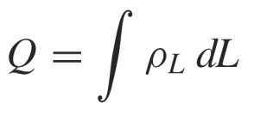
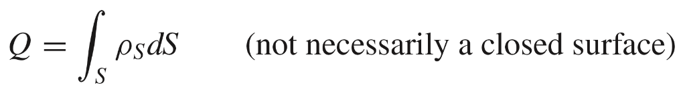
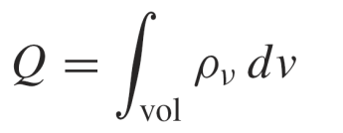
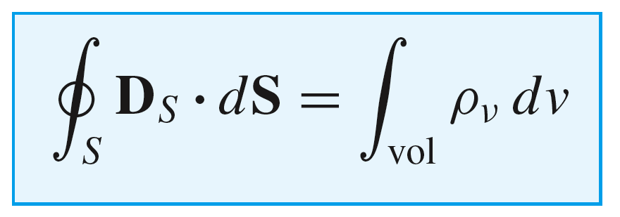
6: Gauss’ Law高斯定律
Gauss’ Law- Its mathematical statement
in which the charge can exist in the form of point charges:
or a continuous charge distribution:
Line charge:
Surface charge:
Volume charge:
For a volume charge, we would have:
13

Slide 15
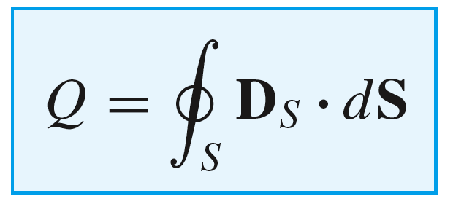


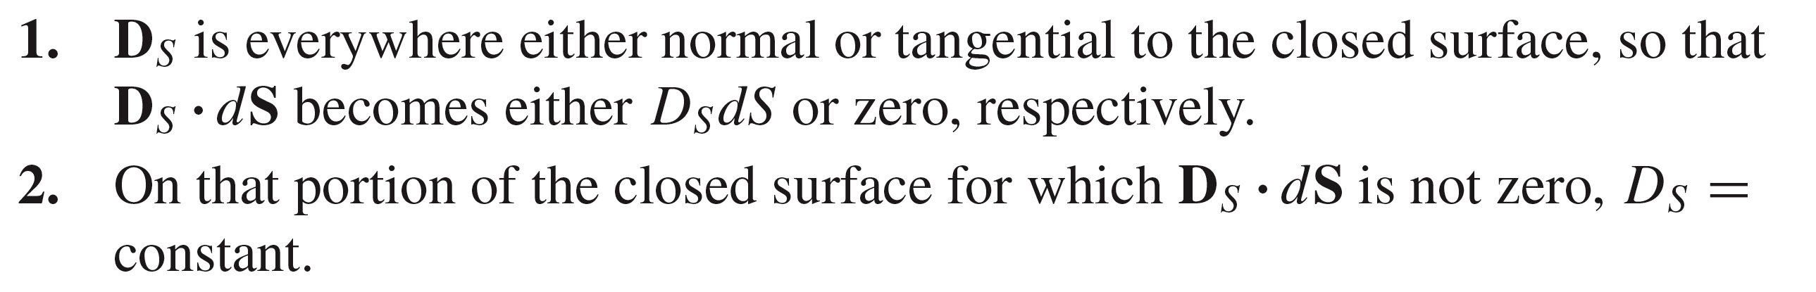
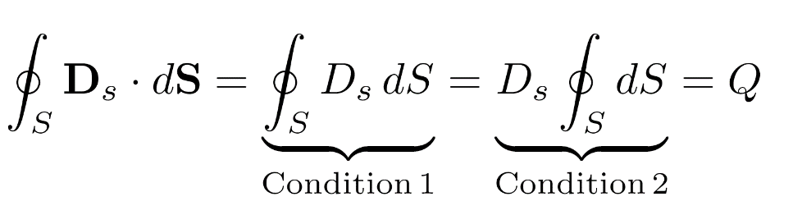
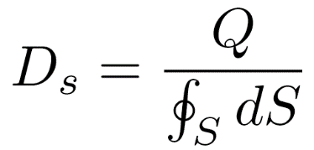
6: Gauss’ Law高斯定律
Using Gauss’ Law to solve for D evaluated at a surface
where
The solution is easy if we can choose a surface, S, over which to integrate (Gaussian surface) that satisfies the following two conditions:
The integral now simplifies:
So that:
14

Slide 16
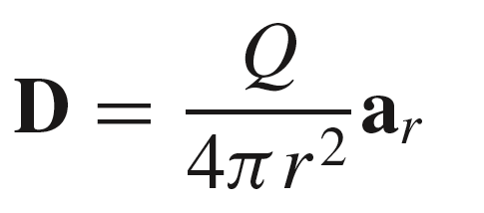
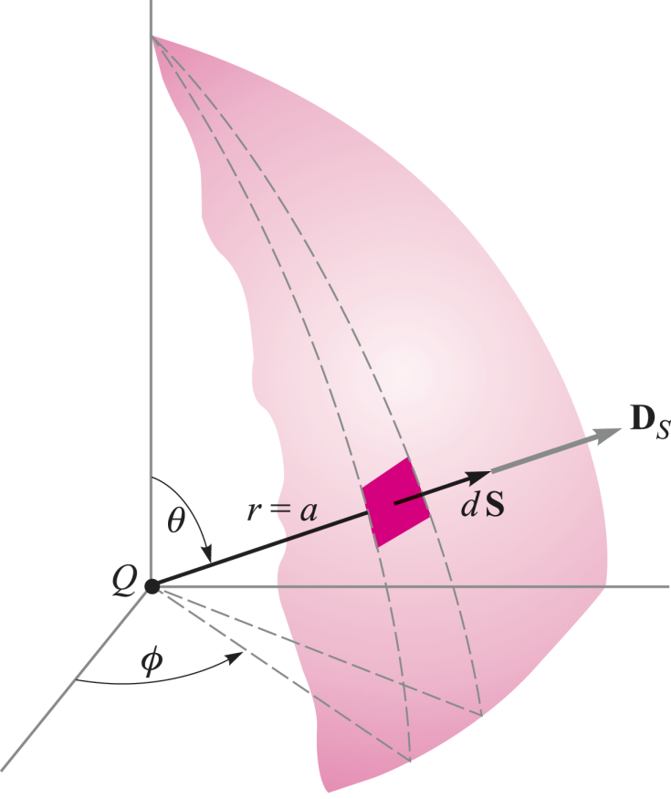
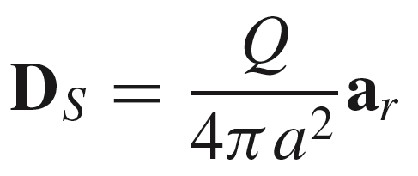
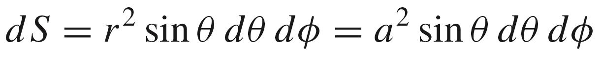
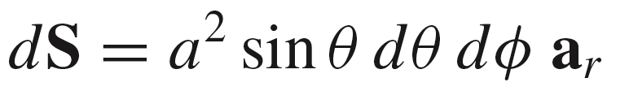
6: Gauss’ Law高斯定律
Example: Point Charge Field
Begin with the radial flux density:
and consider a spherical surface of radius a that surrounds the charge, on which:
On the surface, the differential area is:
and this, combined with the outward unit normal vector is:
15

Slide 17
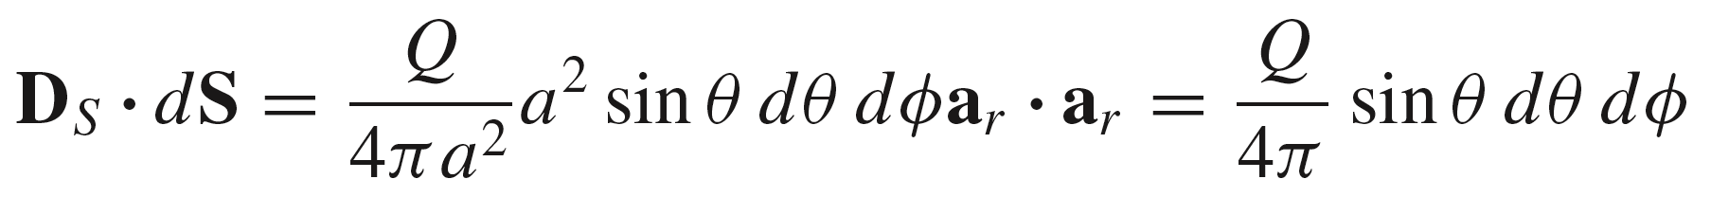
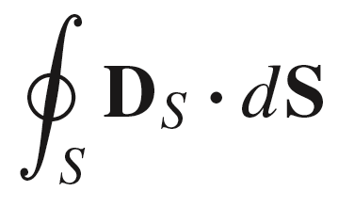
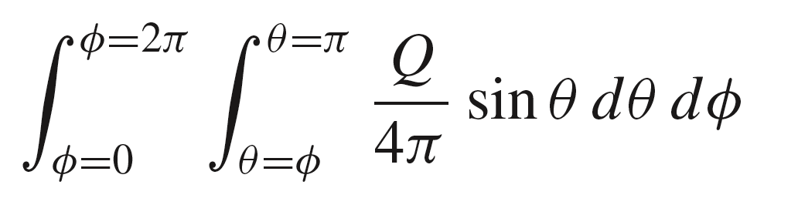
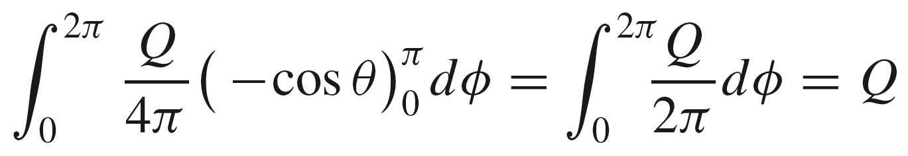
6: Gauss’ Law高斯定律
Example: Point Charge Field
Now, the integrand becomes:
and the integral is set up as:
=
=
16

Slide 18
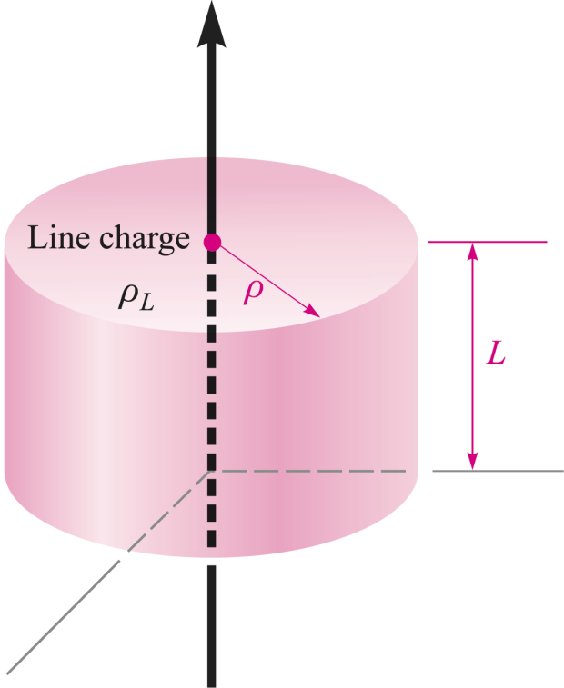
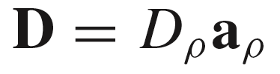
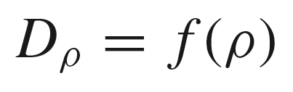
6: Gauss’ Law高斯定律
Example: Line Charge Field
Consider a line charge of uniform charge density ρ_{L} on the z axis that extends over the range −∞ < z < ∞ .
We need to choose an appropriate Gaussian surface, being mindful of these considerations:
We know from symmetry that the field will be radially-directed (normal to the z axis) in cylindrical coordinates:
and that the field will vary with radius only:
So we choose a cylindrical surface of radius ρ, and of length L.
17

Slide 19
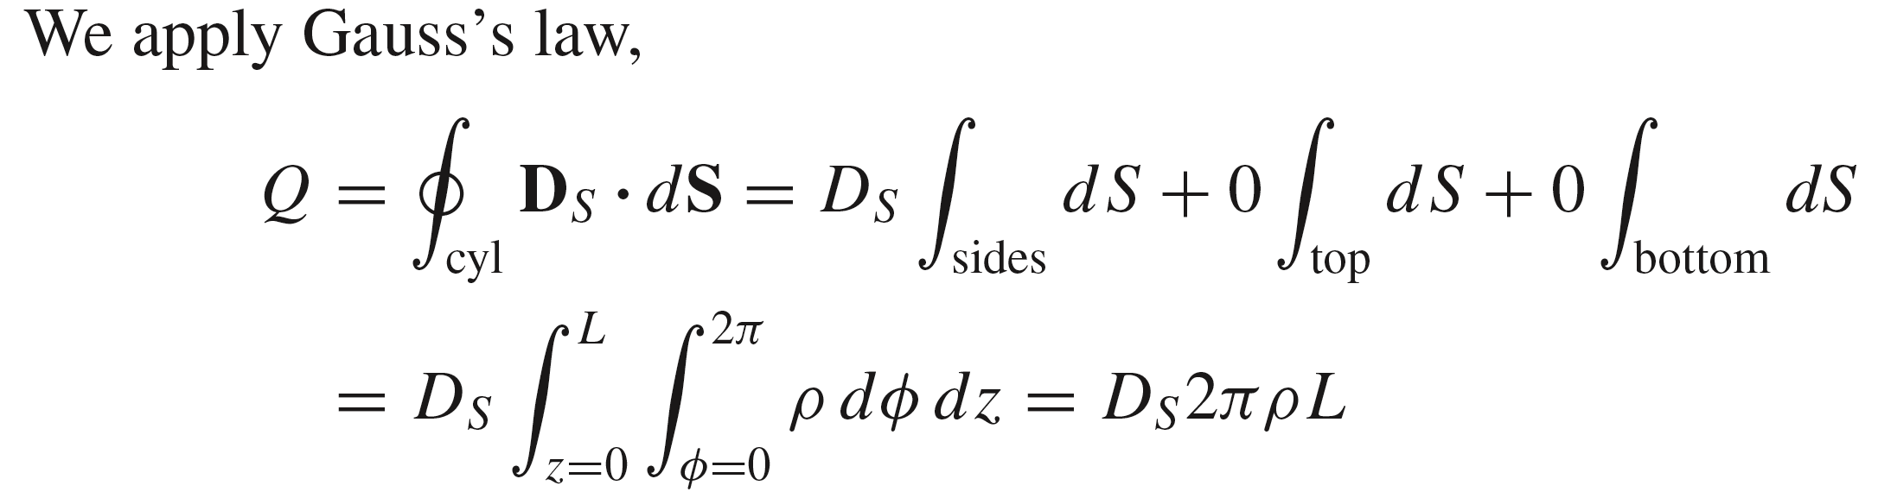
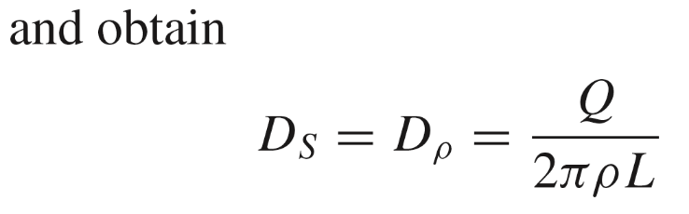
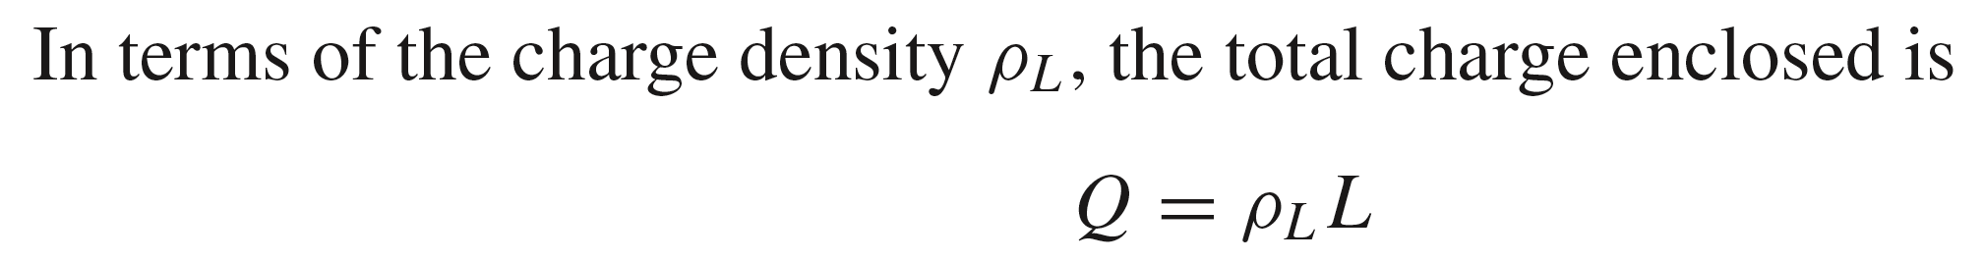
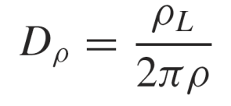
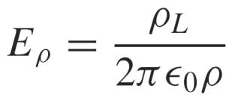
6: Gauss’ Law高斯定律
Example: Line Charge Field
Giving:
So that finally:
Note: Please compare the two methods of solving line charge field intensity E, one by using Gauss’s law and the other by using Coulomb's law.
18

Slide 20
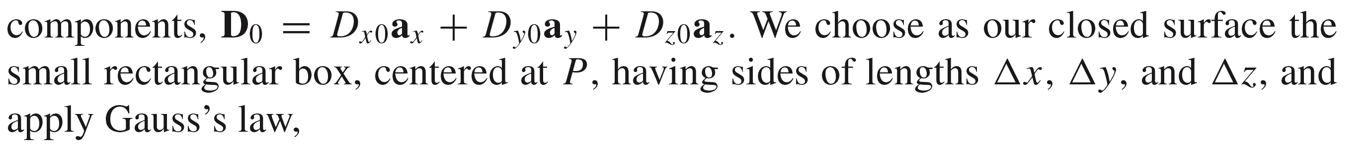
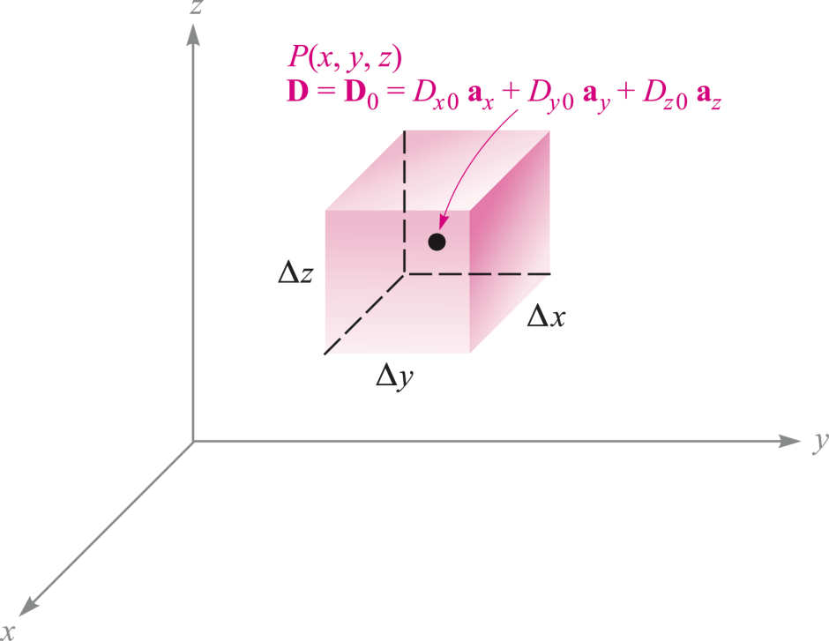


7: Divergence, Maxwell’s First Equation 散度、麦克斯韦第一方程
Electric Flux Within a Differential Volume Element
Taking the front surface, for example, we have:
19

Slide 21




7: Divergence, Maxwell’s First Equation 散度、麦克斯韦第一方程
Electric Flux Within a Differential Volume Element
Taking the front surface, for example, we have:
We now have:
and in a similar manner:
Therefore:
minus sign because D_{x0} is inward flux through the back surface.
20

Slide 22



7: Divergence, Maxwell’s First Equation 散度、麦克斯韦第一方程
Electric Flux Within a Differential Volume Element
Now, by a similar process, we find that:
and
All results are assembled to yield:
= Q
(by Gauss’ Law)
Δv
where Q is the charge enclosed within volume Δv
21

Slide 23

7: Divergence, Maxwell’s First Equation 散度、麦克斯韦第一方程
Divergence 散度
= Q
(by Gauss’ Law)
Δv
where Q is the charge enclosed within volume Δv
当闭合曲面所包围的体积趋近于0时，通量密度A的散度则表示从单位体积的表面穿出的通量。
Mathematically, this is:
22

Slide 24



7: Divergence, Maxwell’s First Equation 散度、麦克斯韦第一方程
Maxwell’s first equation 麦克斯韦第一方程
= Q
(by Gauss’ Law)
Δv
James Clerk Maxwell
(1831－1879)
and when the vector field is the electric flux density:
= div D
Maxwell’s first equation
Note: Essentially, Maxwell’s first equation is the differential form of Gauss’s Law.
本质上，麦克斯韦第一方程是高斯定律的一种微分表达形式。
23

Slide 25



7: Divergence, Maxwell’s First Equation 散度、麦克斯韦第一方程
Divergence Expressions in the Three Coordinate Systems 散度如何计算？在三种不同坐标系中的表达
Note: 1) 只有通量密度才能定义散度，而通量密度一定是矢量；
2) 矢量的散度是标量。
24

Slide 26




7: Divergence, Maxwell’s First Equation 散度、麦克斯韦第一方程
The Del Operator 矢量Del算子
The del operator is a vector differential operator, and is defined as:
Note that:
=
= div D
25

Slide 27



7: Divergence, Maxwell’s First Equation 散度、麦克斯韦第一方程
Divergence Theorem 散度定理
We now have Maxwell’s first equation (or the point form of Gauss’ Law) which states:
and Gauss’s Law in large-scale form reads:
leading to the Divergence Theorem:
26

Slide 28

7: Divergence, Maxwell’s First Equation 散度、麦克斯韦第一方程
Divergence Theorem 散度定理
The integral of the normal component of any vector field over a closed surface is equal to the integral of the divergence of this vector field throughout the volume enclosed by the closed surface.
任意矢量场的法向分量在闭合面上的面积分等于它的散度在闭合面所包围的体积内的体积分。
Note: Divergence Theorem is applicable to any vector field.
散度定理适用于任意矢量场。
27

Slide 29


7: Divergence, Maxwell’s First Equation 散度、麦克斯韦第一方程
Example:
z
3
0
2
y
1
x
28

Slide 30


7: Divergence, Maxwell’s First Equation 散度、麦克斯韦第一方程
Example:
z
3
0
2
y
1
x
29

Slide 31


7: Divergence, Maxwell’s First Equation 散度、麦克斯韦第一方程
Example:
z
3
0
2
y
1
x
30

Slide 32

HW-3
31

